Slide 1
Oxford Parkinson's Disease Telemonitoring Dataset
The dataset was created by Athanasios Tsanas and Max Little of the University of Oxford, in collaboration with 10 medical centers in the US and Intel Corporation who developed the telemonitoring device to record speech signals. The original study used a range of linear and nonlinear regression methods to predict the clinician's Parkinson's disease symptom score on the UPDRS scale.
This dataset is composed of a range of biomedical voice measurements from 42 people with early-stage Parkinson's disease recruited to a six-month trial of a telemonitoring device for remote symptom progression monitoring. The recordings were automatically captured in the patient's homes.
The rows of the dataset contain an instance corresponding to one voice recording. There are around 200 recordings per patient.
R­²=0.18; n=5875; p=19

Slide 2
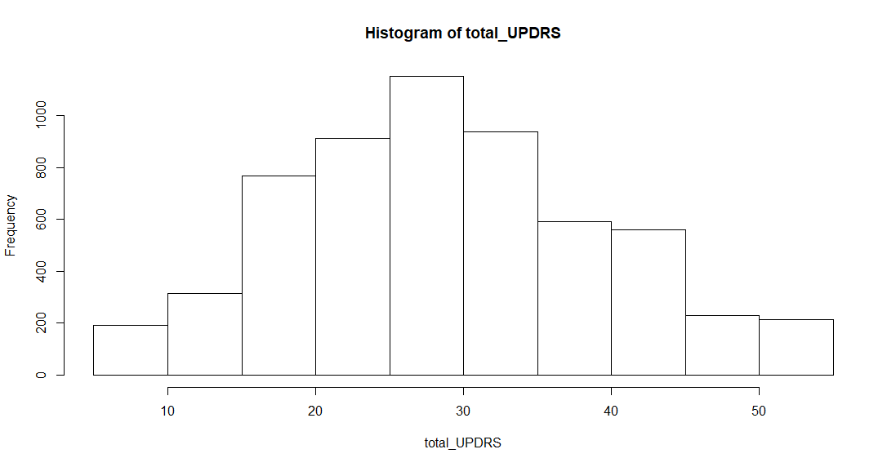
Response variable

Slide 3
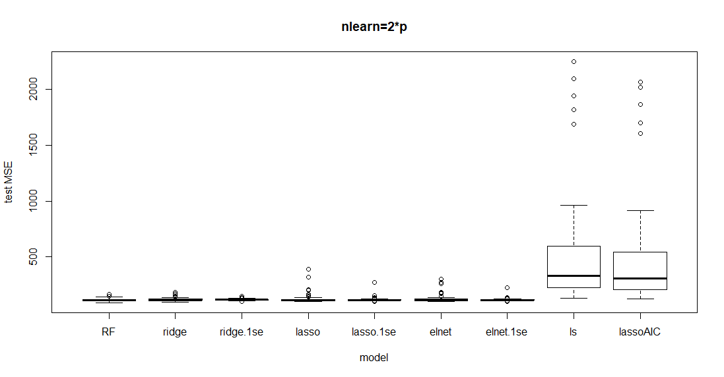
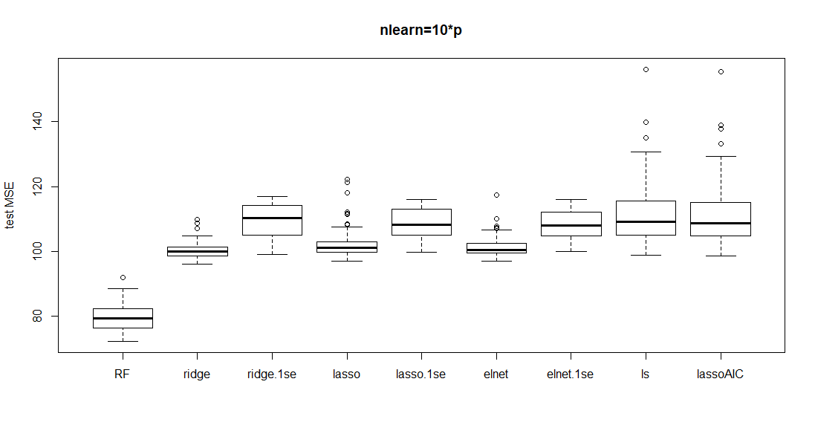
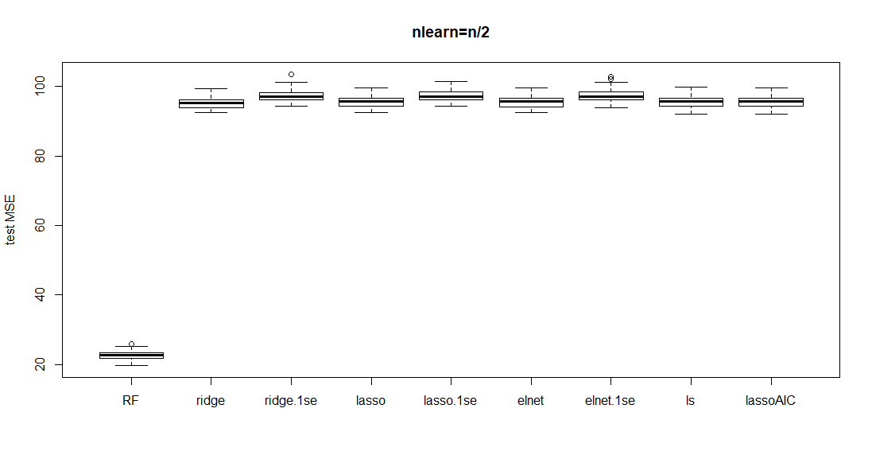

Slide 4
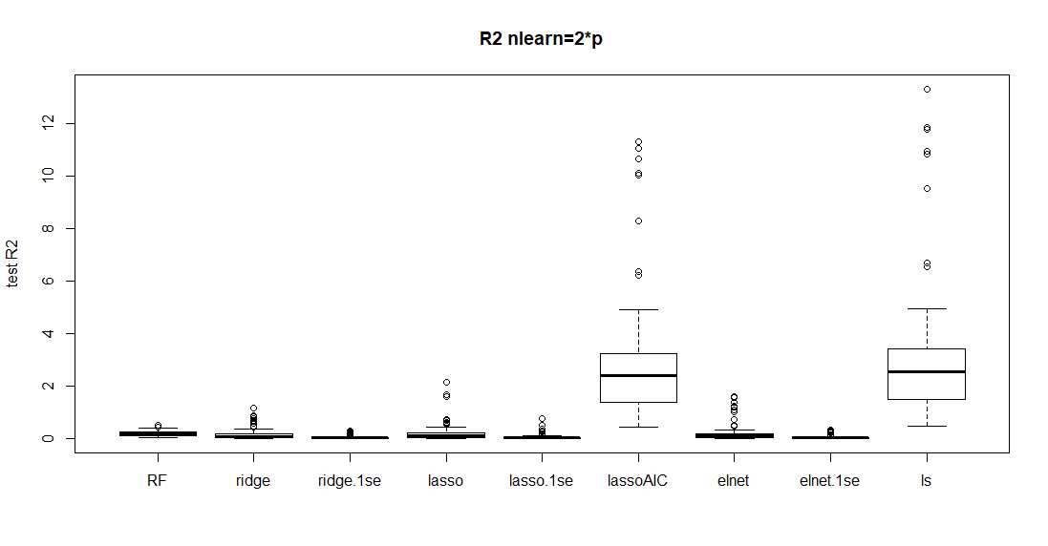
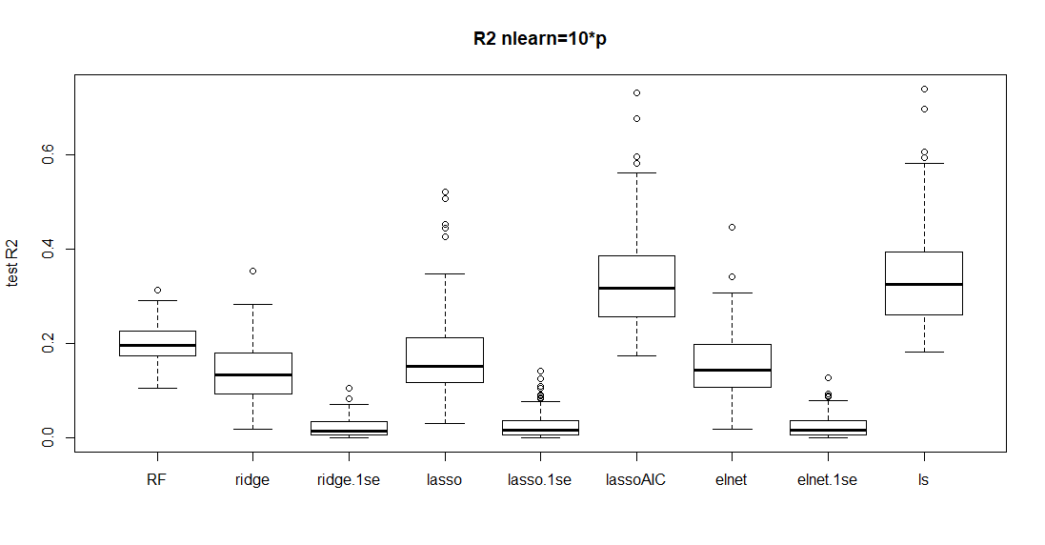
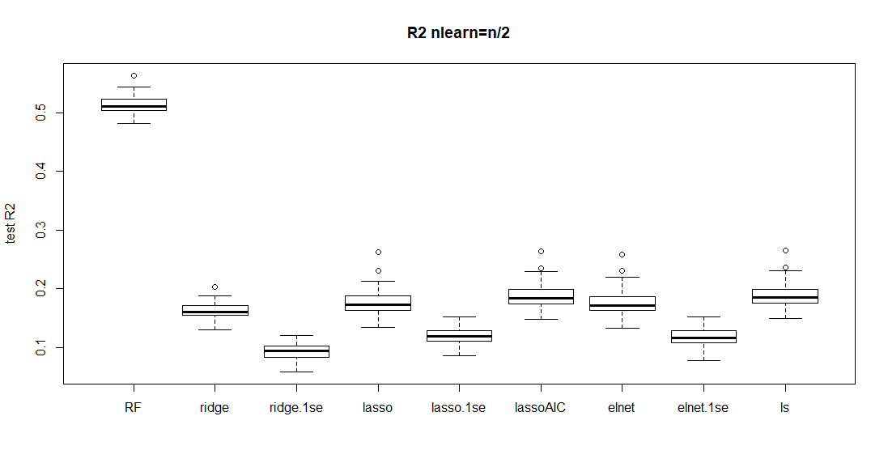

Slide 5
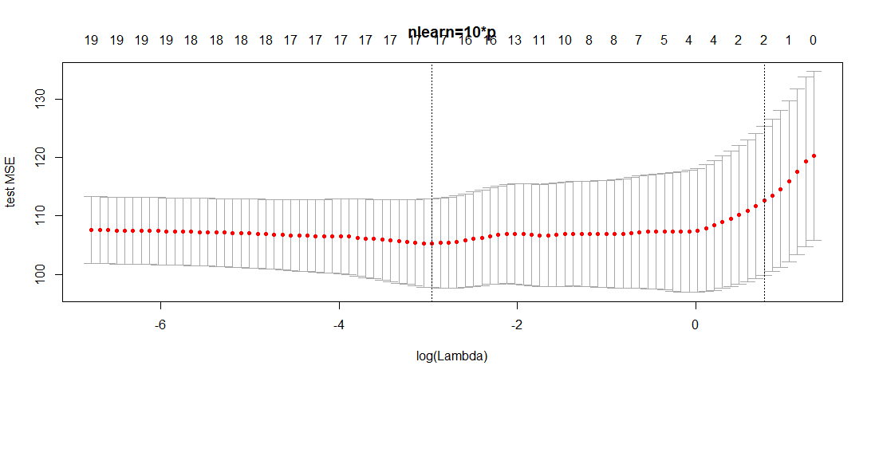
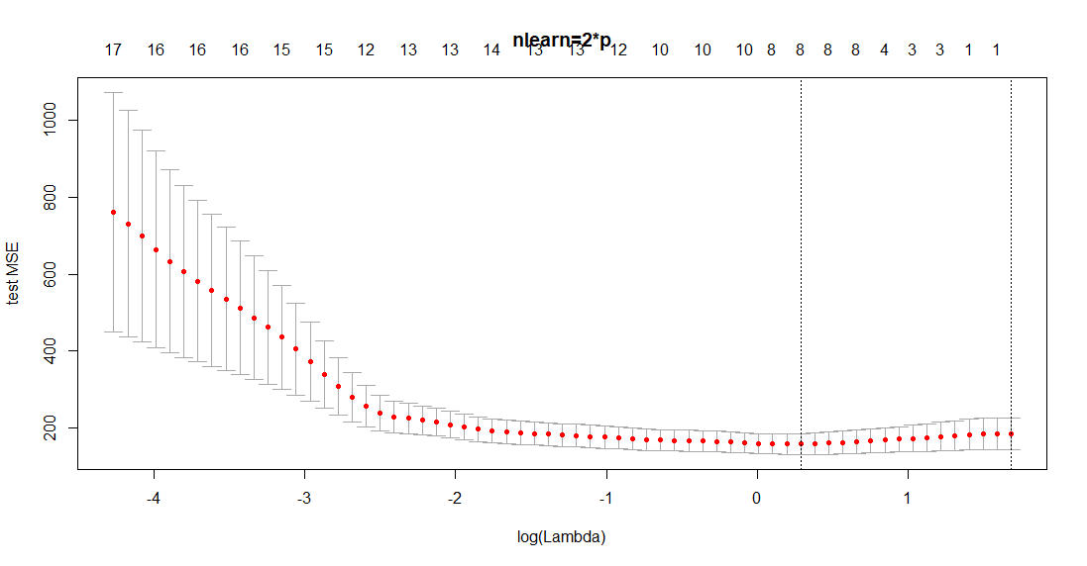
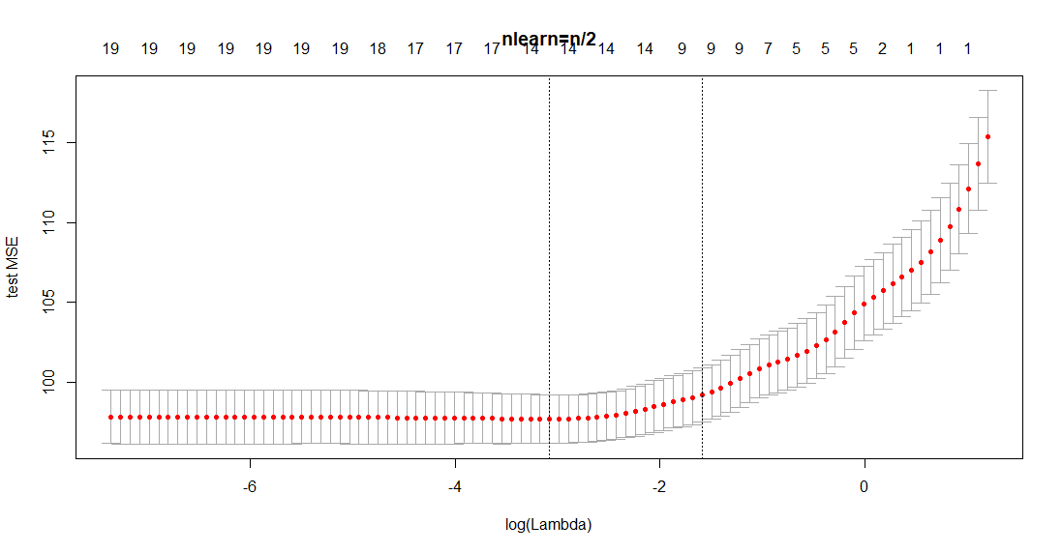

Slide 6
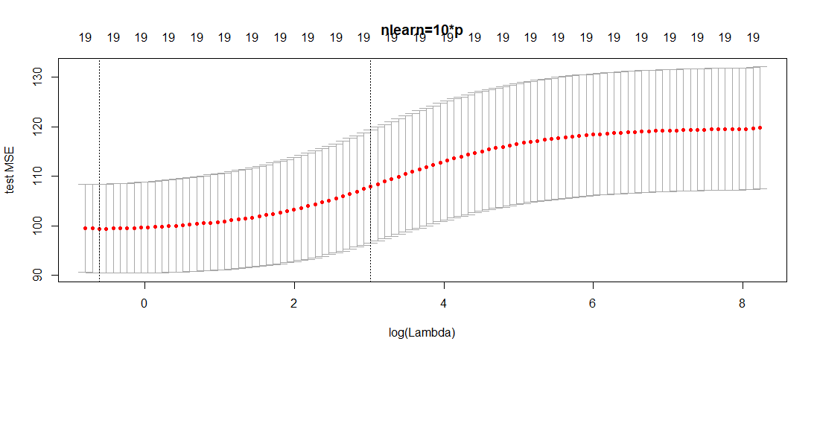
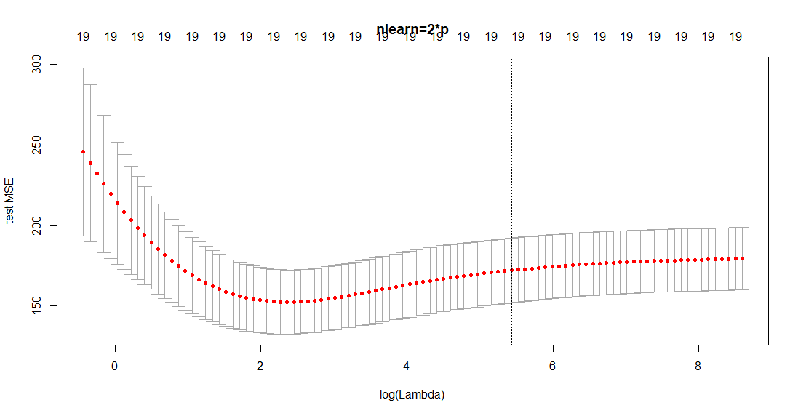
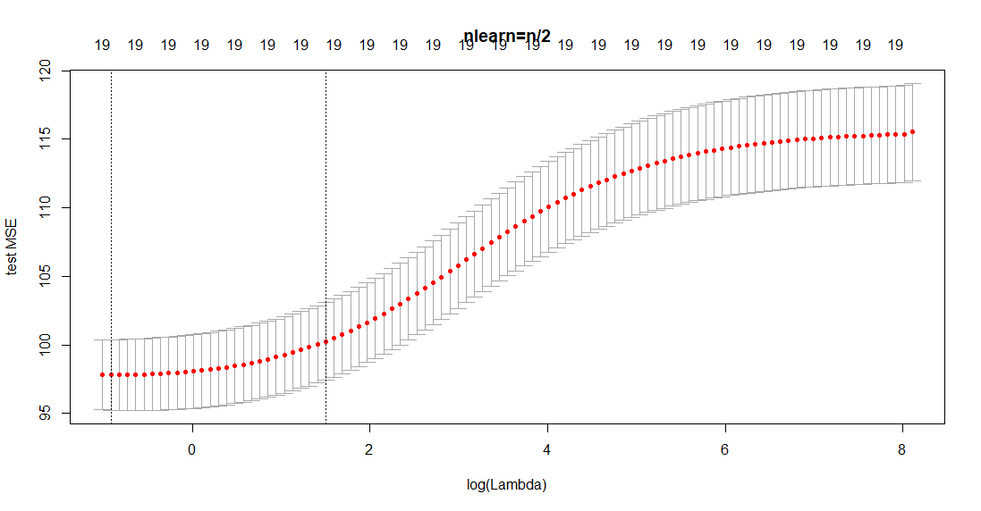

Slide 7
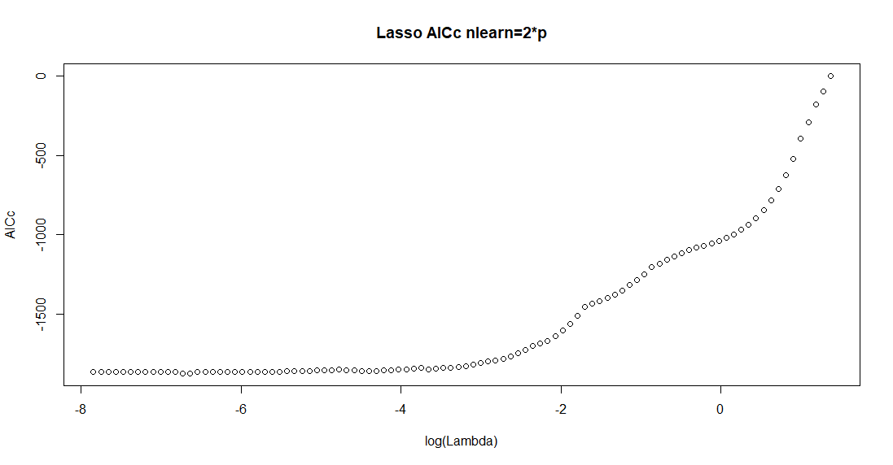
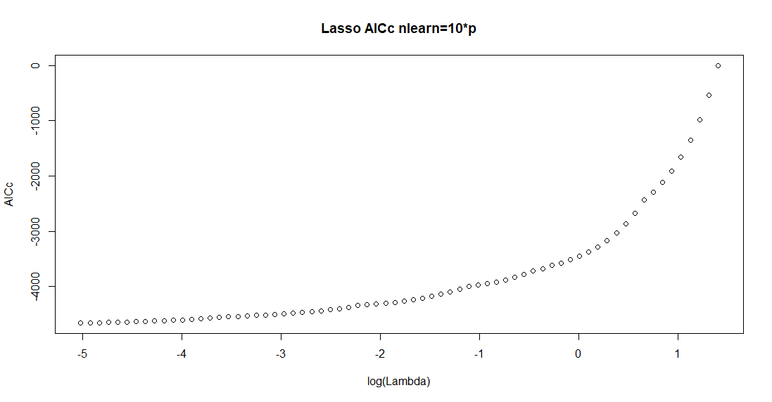
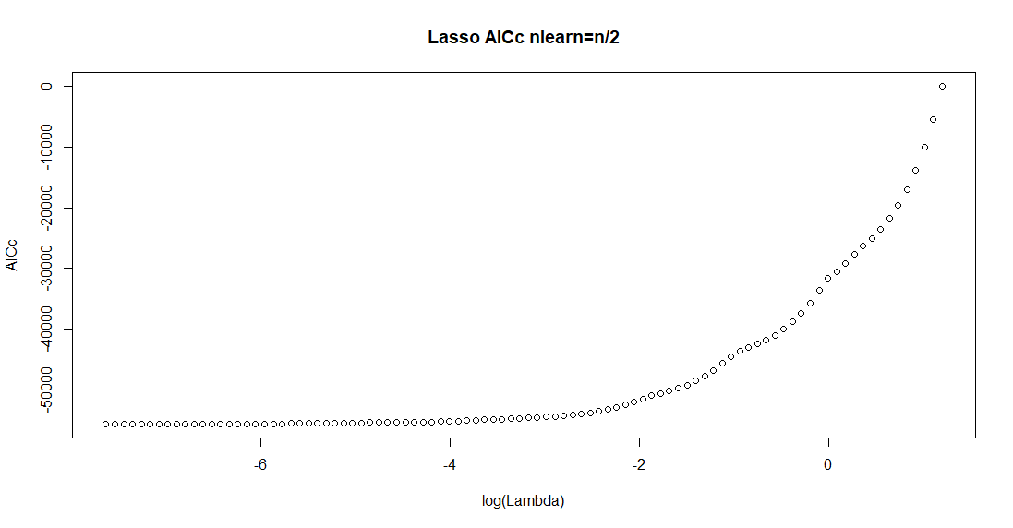

Slide 8
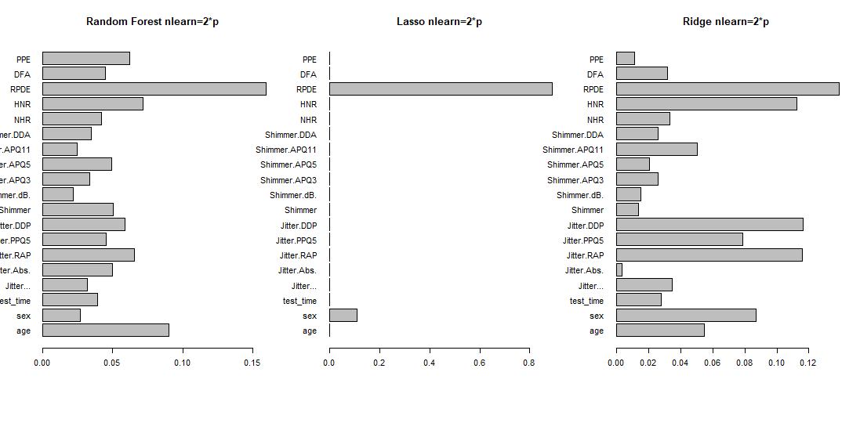

Slide 9
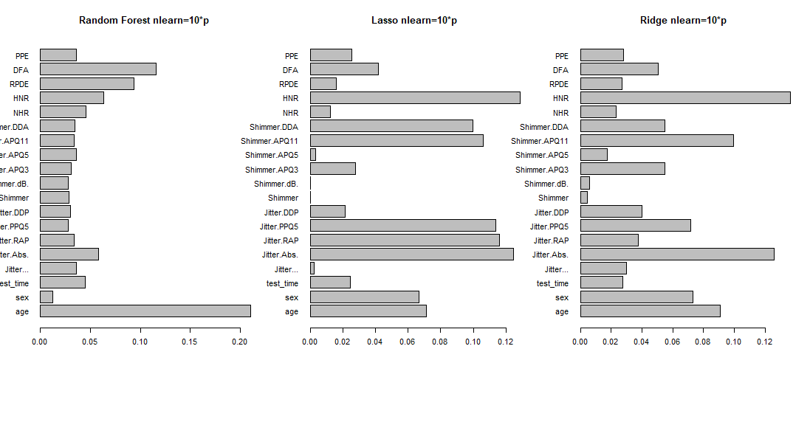

Slide 10
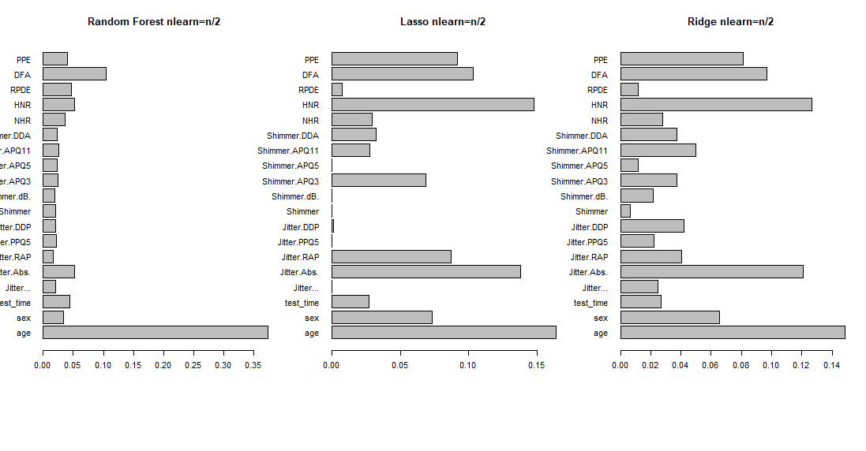

Slide 11
tLL = lasso.mod$nulldev - deviance(lasso.mod)
r = lasso.mod$df
t = lasso.mod$nobs
AICc = -tLL+2*r+2*r*(r+1)/(t-r-1)
tLL is twice the maximized loglikelihood

